Slide 1
Software Engineering

Slide 2
INTRODUCTION

Slide 3
What is Software Engineering?
Fritz Bauer : “The establishment and use of sound engineering principles in order to obtain economically developed software that is reliable and works efficiently on real machines.”
Stephan Schach: “ A discipline whose aim is the production of quality software, software that is delivered on time, within budget, and that satisfies its requirements.”
Notes:
Engineering is the creative application of science, mathematical methods, and empirical evidence to the innovation, design, construction, operation and maintenance of structures, machines, materials, devices, systems, processes, and organizations.

Slide 4
Project Management Statistics on Failure
1. 70 percent of projects fail. [source: 4 PM] 2. The failure of IT costs the U.S. economy about $50-$150 billion annually. [source: Harvard Business Review] 3. Just 40 percent of projects at IBM meet the company's three key goals (schedule, budget, and quality). [source: IBM] 4. Three-quarter of projects fail because senior management doesn’t get involved. [source: Capterra] 5. 17 percent of IT projects go so badly, they threaten the existence of the company. [source: McKinsey & Company in conjunction with the University of Oxford]

Slide 5
6. Only 2.5 percent of companies successfully complete 100 percent of their projects. [source: Gallup]
7. 57 percent of projects fail due to breakdown in communications. [source: IT Cortex]

Slide 6
Major problem of Software industry?
Inability to develop bug free software. (Leads to a situation called Software Crisis)

Slide 7

Some Software Failures
Examples:
The “star wars” program of USA produced “Patriot missile”, used for the first time in Gulf war.
A defence for Iraqi Scud missiles.
Failed several times to hit Scud missiles, including one that killed 28 US soldiers in Dhahran, Saudi Arabia.
Bug: A small timing error in the system’s clock accumulated to the point that after 14 hours, the tracking system was no longer accurate.

Slide 8
The Year 2000, the millennium bug or Y2K problem: Most crucial problem of last century.
Problem? Simply the ignorance about the adequacy or otherwise of using only last two digits of the year.
The developers could not visualize the problem of year 2000.
Millions of rupees have been spent to handle this practically non-existent problem.

Slide 9
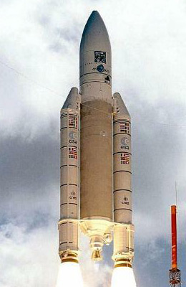
“One little bug, one big crash” of Ariane-5 space rocket
Was developed at a cost of $7000M over a 10 year period.
Bug? When the computer system tried to convert one piece of data- the sideways velocity of the rocket- from a 64 bit format to a 16 bit format; the number was too big, and the overflow error resulted after 36.7 seconds.

Slide 10
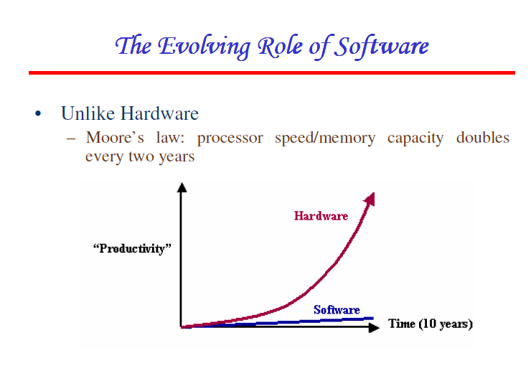

Slide 11
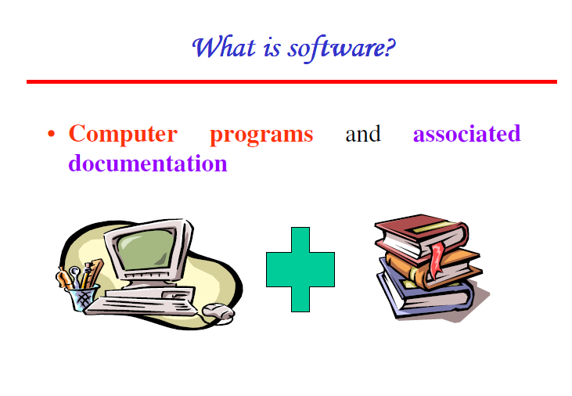

Slide 12
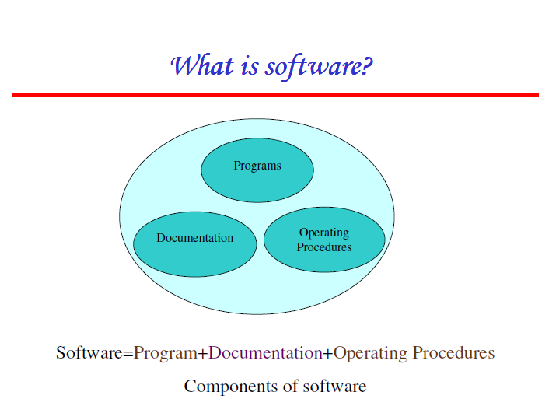

Slide 13
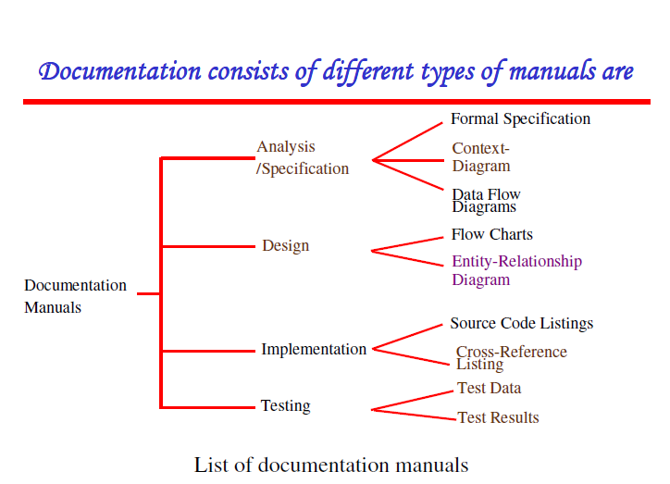

Slide 14
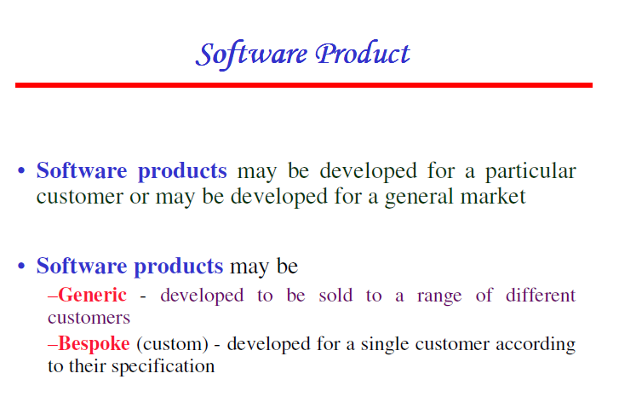
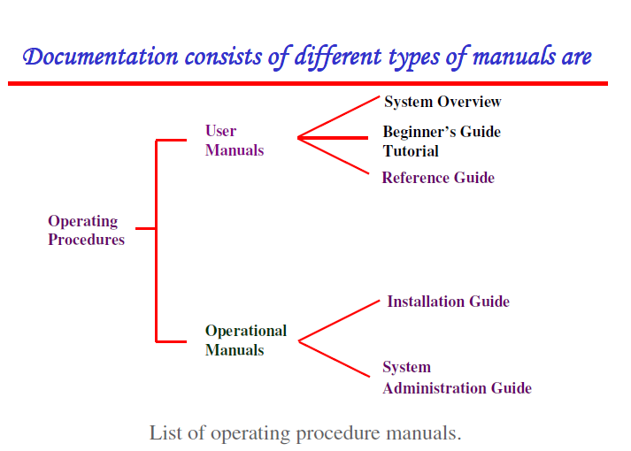

Slide 15
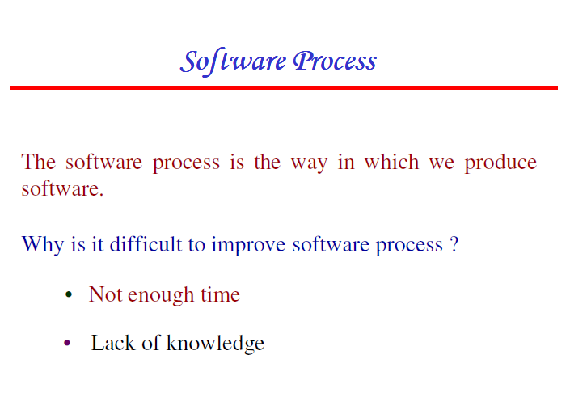
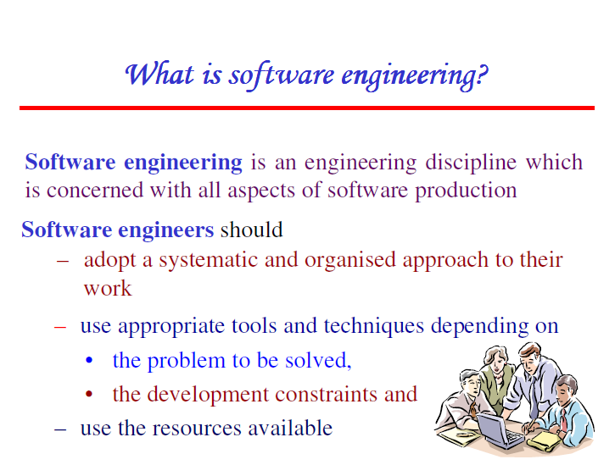
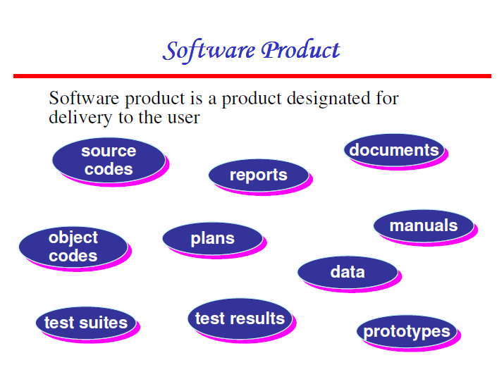

Slide 16
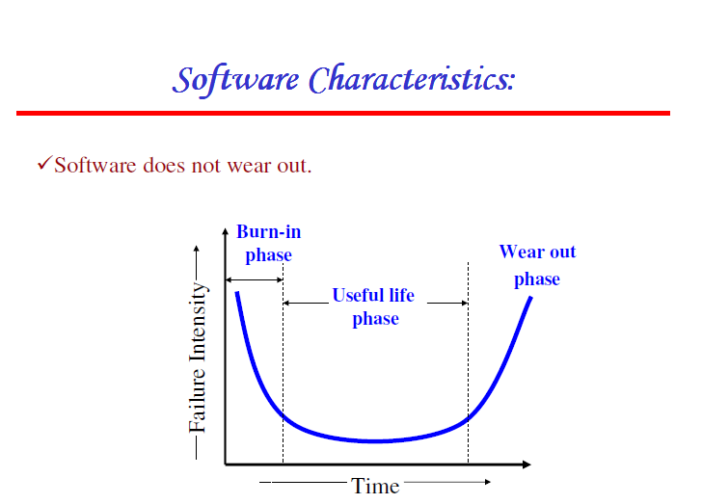

Slide 17
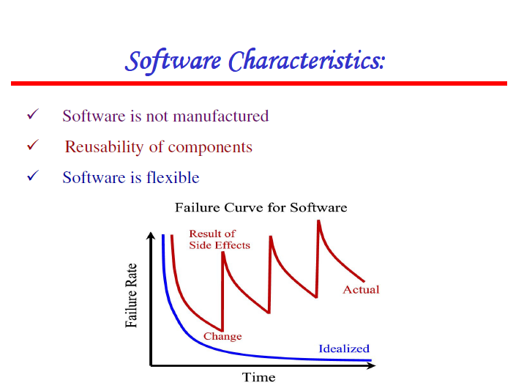

Slide 18
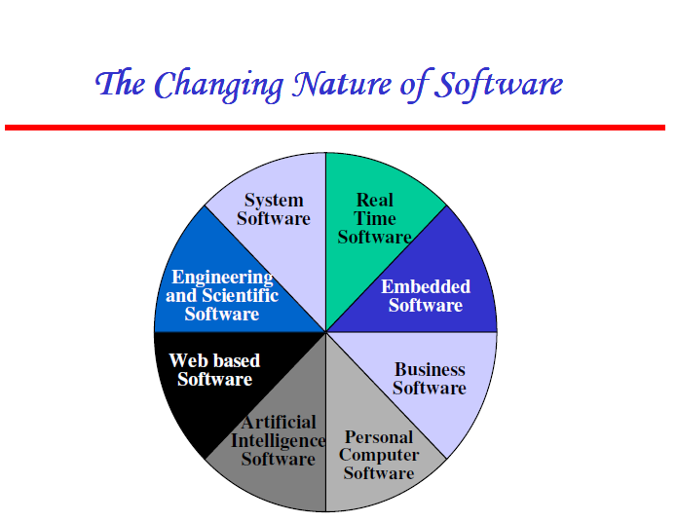

Slide 19
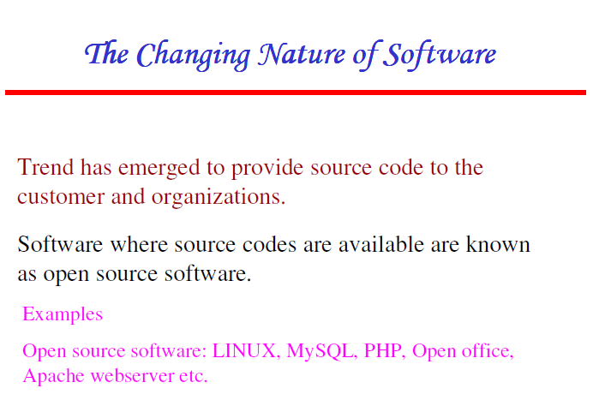

Slide 20
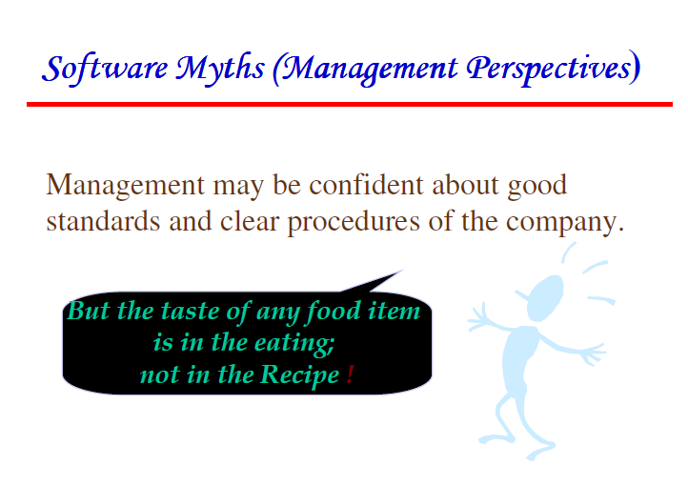

Slide 21
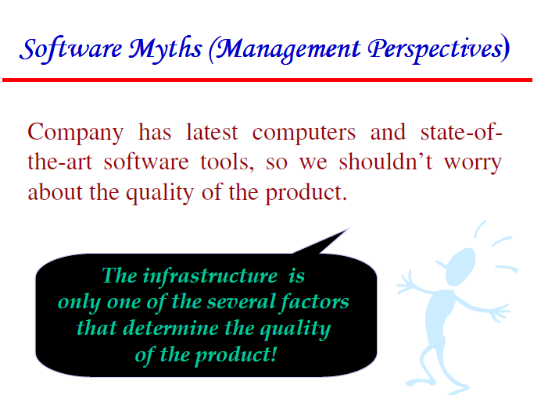

Slide 22
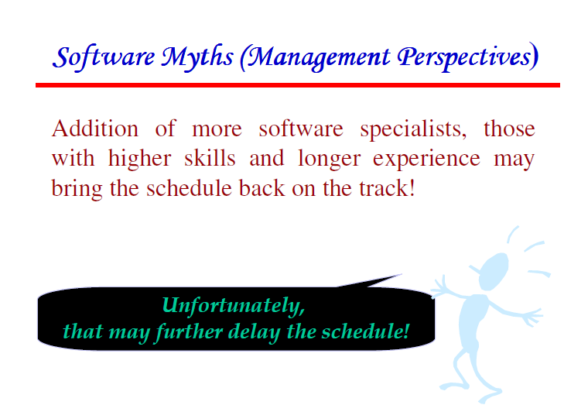

Slide 23
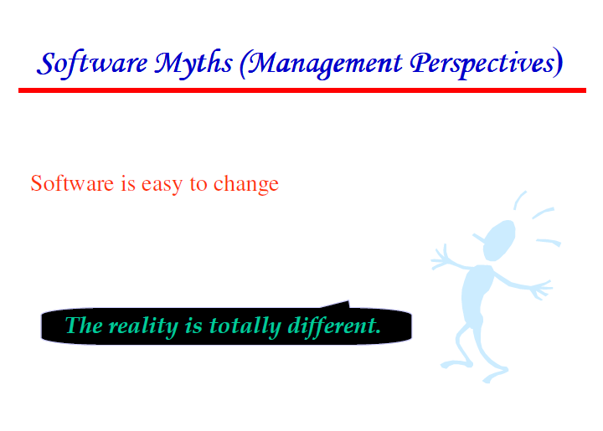

Slide 24
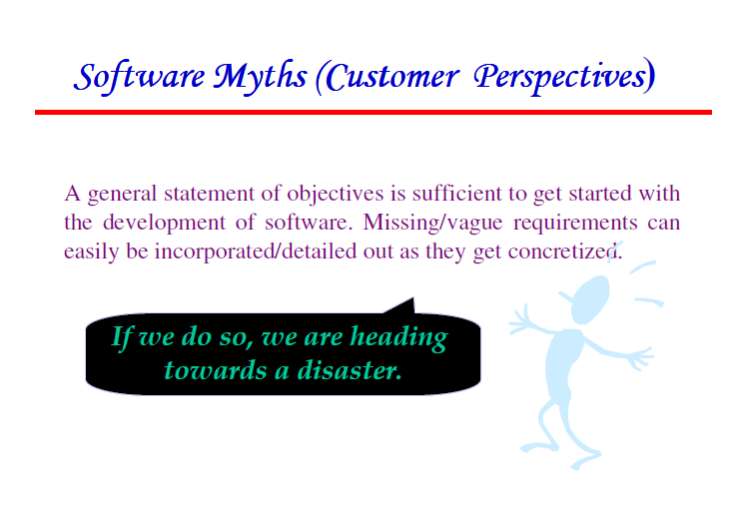

Slide 25
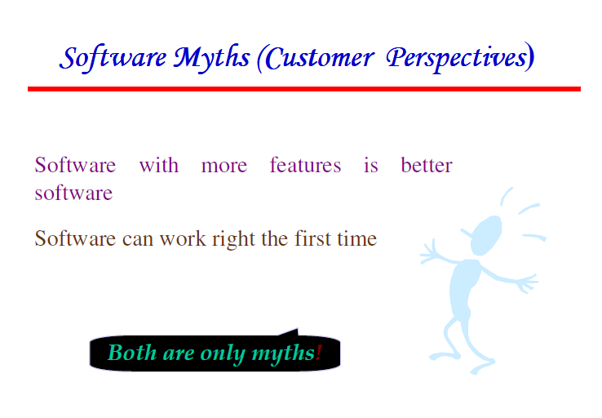

Slide 26
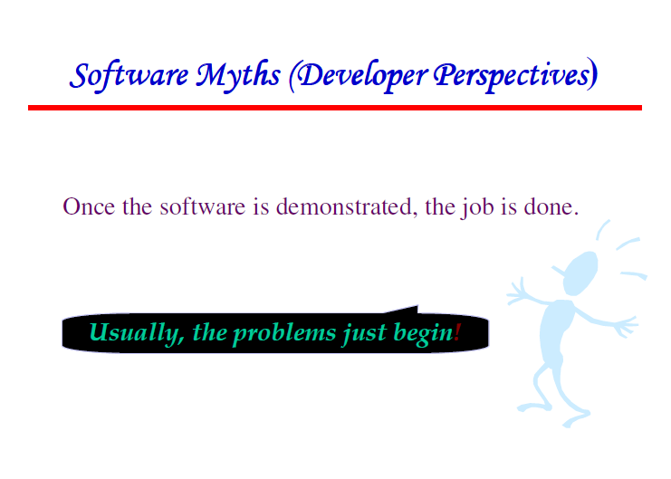

Slide 27
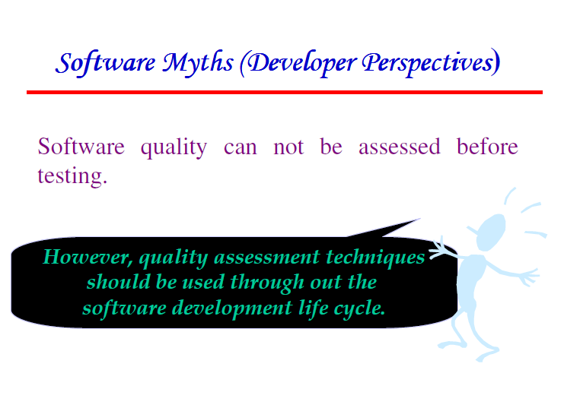

Slide 28
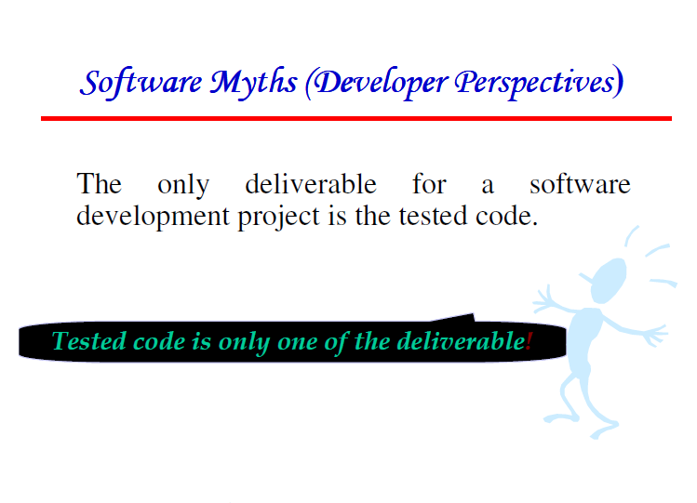

Slide 29
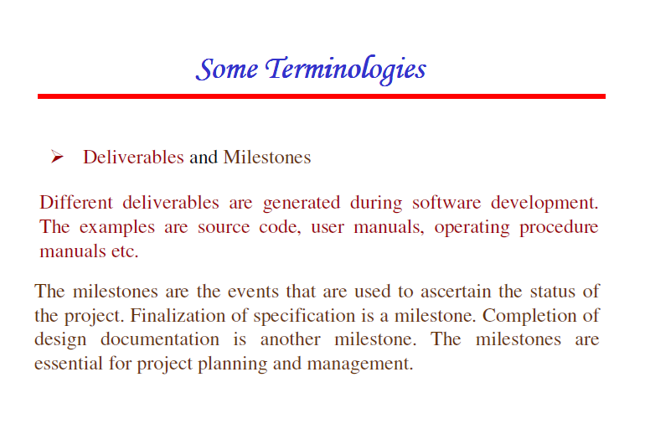

Slide 30
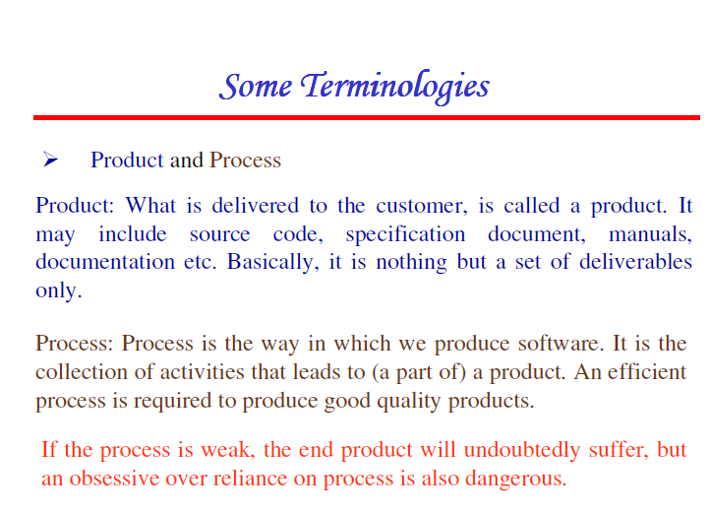

Slide 31
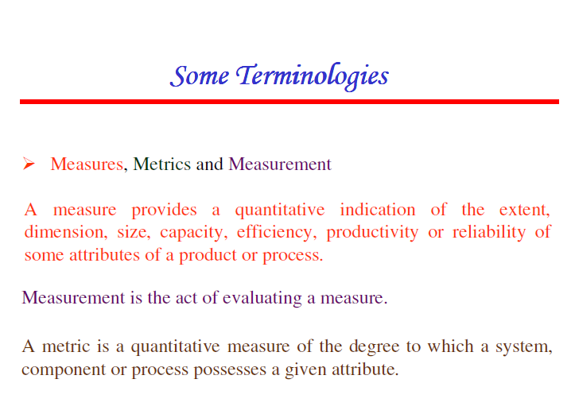

Slide 32
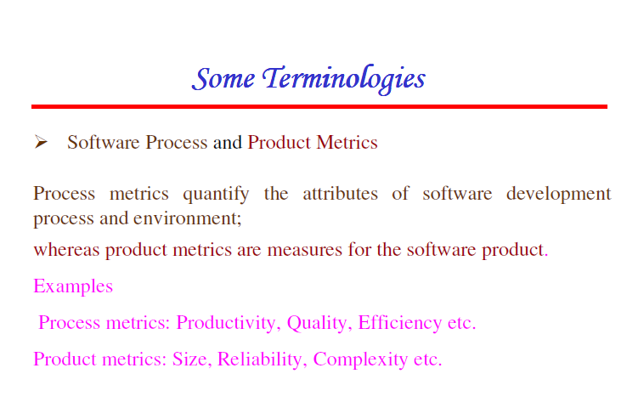

Slide 33
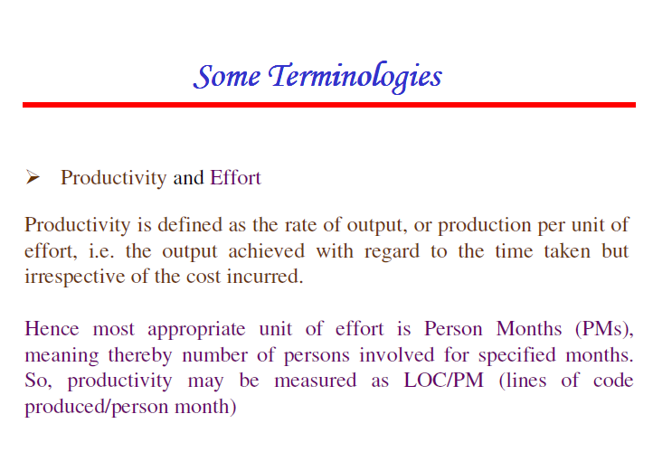

Slide 34
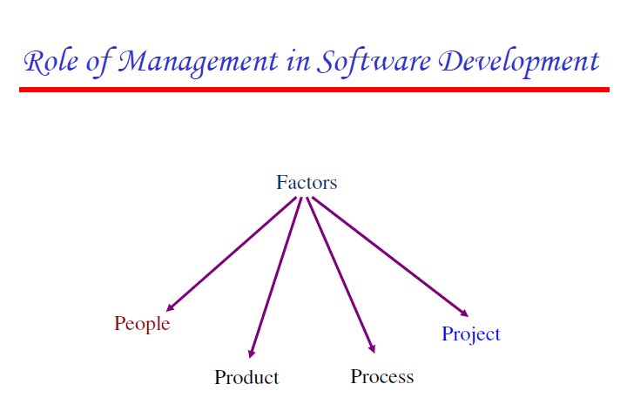

Slide 35
Software Life Cycle Models

Slide 36
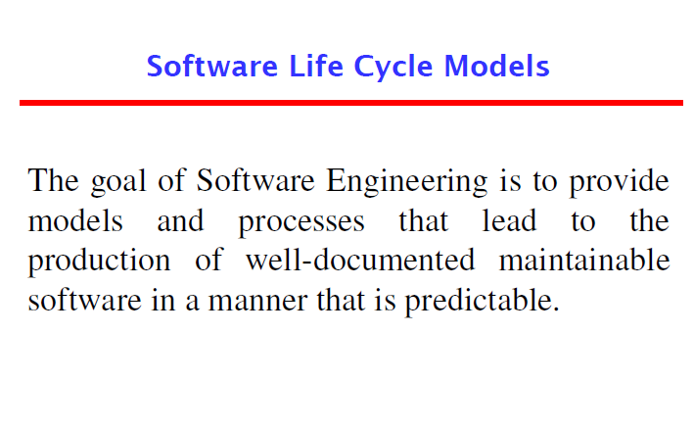

Slide 37
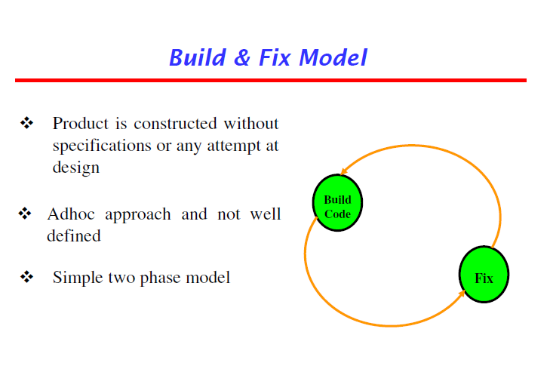

Slide 38
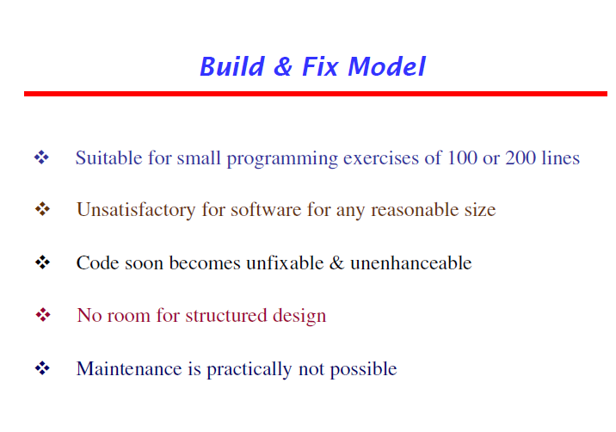

Slide 39
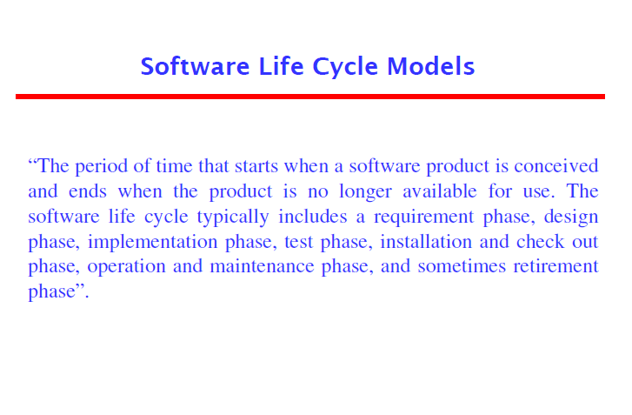

Slide 40
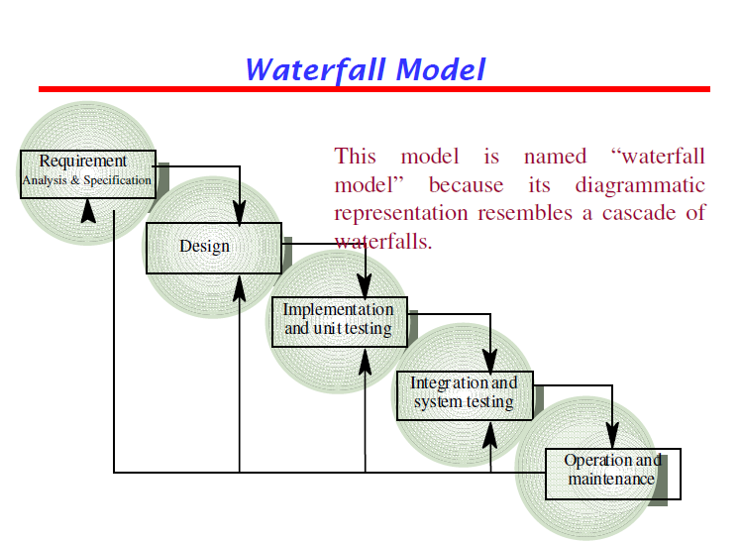

Slide 41
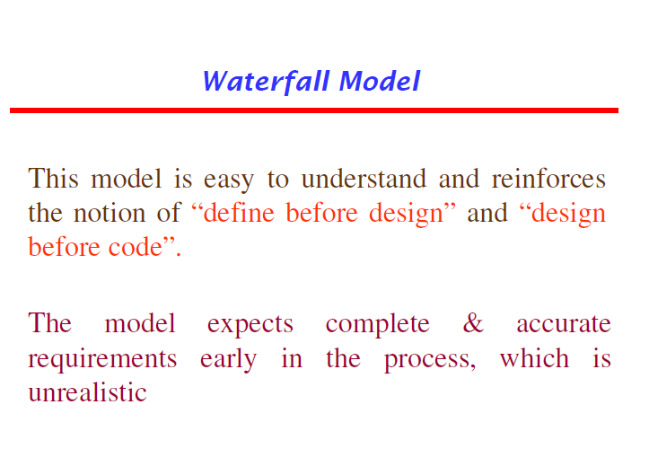

Slide 42
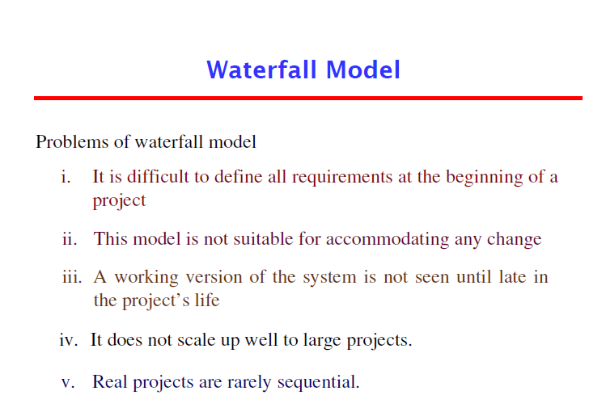

Slide 43
Increment models
Increment process models are effective in the situations where requirements are defined precisely and there is no confusion about the functionality of the final product.
After every cycle, a usable product is given to the customer.
Popular particularly when we have to quickly deliver a limited functionality.
Types:
Iterative Enhancement Model
The Rapid Application Development (RAD) Model

Slide 44
Iterative Enhancement Model
This model has the same phases as the waterfall model, but with fewer restrictions.
Generally the phases occur in the same order as in the waterfall model, but they may be conducted in several cycles.
Usable product is released at the end of each cycle, with each release providing additional functionality.

Slide 45
Customers and developers specify as many requirements as possible and prepare a SRS document.
Developers and customers then prioritize these requirements.
Developers implement the specified requirements in one or more cycles of design, implementation and test based on the defined priorities.

Slide 46
In contrast to waterfall model, this model does deliver an operational quality product at each release, but one that satisfies only a subset of the customer’s requirements.
The complete product is divided into releases, and the developer delivers the product release by release.

Slide 47
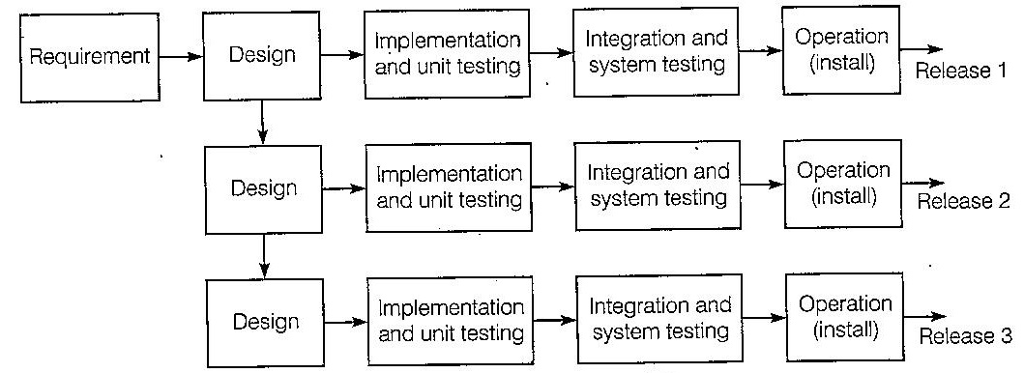
Fig: Iterative Enhancement Model

Slide 48
The Rapid Application Development(RAD) model
Developed by IBM in the 1980s
Here, user involvement is essential from requirement phase to delivery of the product.
The continuous user participation ensures the involvement of user’s expectations and perspective in requirements elicitation, analysis and design of the system.

Slide 49
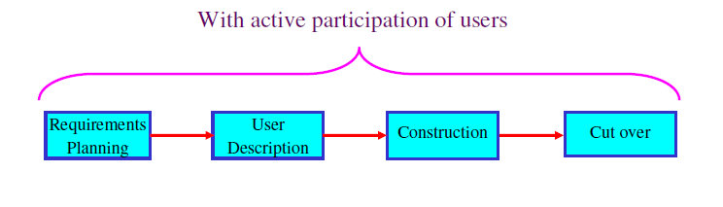
The process is started with building a rapid prototype and is given to user for evaluation.
The user feedback is obtained and the prototype is refined.
The process continues, till the requirements are finalized.
Group techniques such as FAST, QFD, Brainstorming Sessions can be used.

Slide 50
Evolutionary process models
Resembles iterative enhancement model in the sense that the product is developed in parts.
But different in the sense that this does not require a useable product at the end of each cycle.
Here, requirements are implemented by category rather than by priority.
Types:
Prototyping Model
Spiral Model

Slide 51
Prototype Model
This model overcomes the disadvantage of delay in discovery of serious errors which is faced in waterfall model.
Here, we first develop a working prototype of the software instead of developing the actual software.
The working prototype is developed as per current available requirements.
The developers use this prototype to refine the requirements and prepare the final specification document.
Because the working prototype has been evaluated by the customer, it is reasonable to expect that the resulting specification document will be correct.

Slide 52
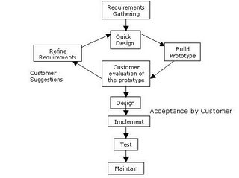

Slide 53
Spiral Model
Problem with traditional software process models is that they do not deal sufficiently with the uncertainty.
Important software projects have failed because project risks were neglected and nobody was prepared when something unforeseen happened.
Barry Bohem recognized this and tried to incorporate the “project risk” factor into a life cycle model which resulted in the spiral model.

Slide 54
The radial dimension of the model represents the cumulative costs.
Each path around the spiral is indicative of increased costs.
The angular dimension represents the progress made in completing each cycle.
Each loop of the spiral form X-axis clockwise through 360 degrees represents one phase.

Slide 55
One phase is roughly split into four sectors of major activities:
Planning: Determination of objectives, alternatives and constraints.
Risk analysis: Analyze alternatives and attempts to identify and resolve the risks involved.
Development: Product development and testing product.
Assessment: Customer evaluation.

Slide 56
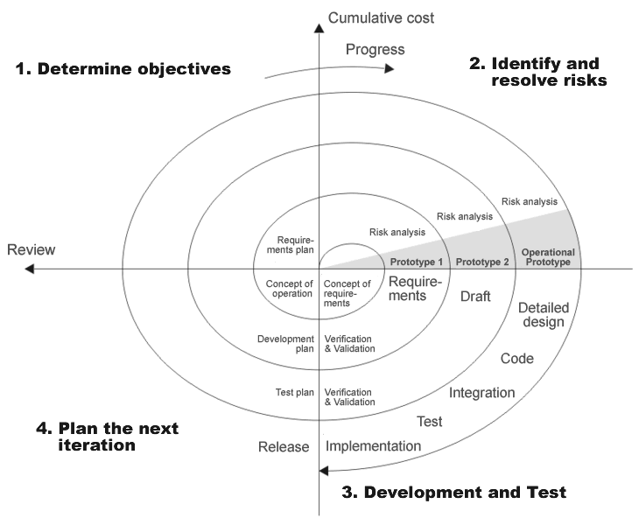

Slide 57
Advantages:
Risk reduction
Functionality can be added
Software is produced early
Disadvantages:
Risk analysis requires on highly skilled expertise
Highly dependent on risk analysis
More complex than other models and therefore, costly to implement.

Slide 58
Selection of a lifecycle model
Selected on the basis of the following characteristics /categories:
Requirements
Development team
Users
Project type and associated risk

Slide 59
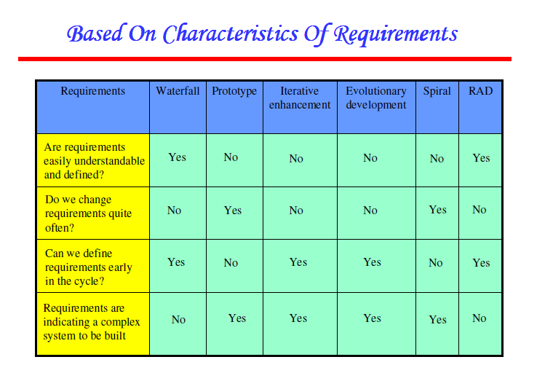

Slide 60
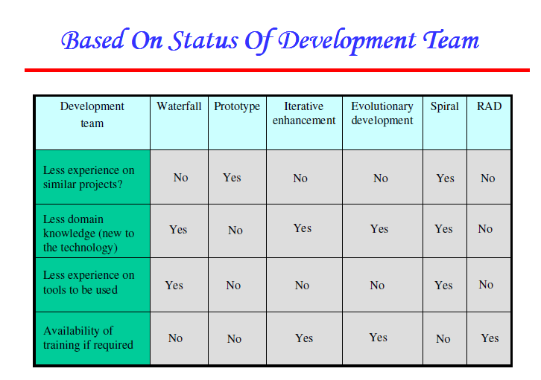

Slide 61
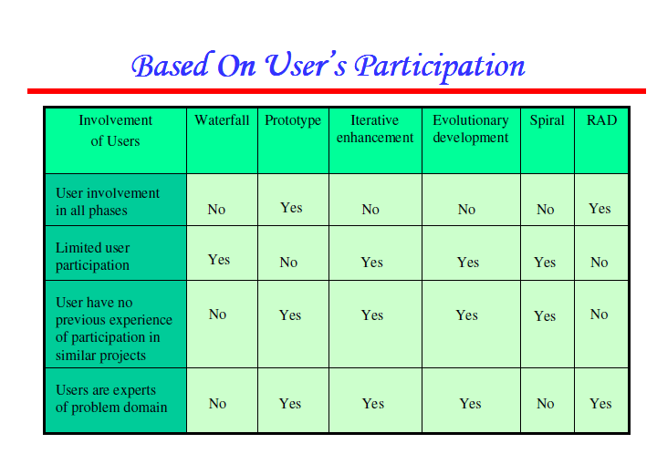

Slide 62
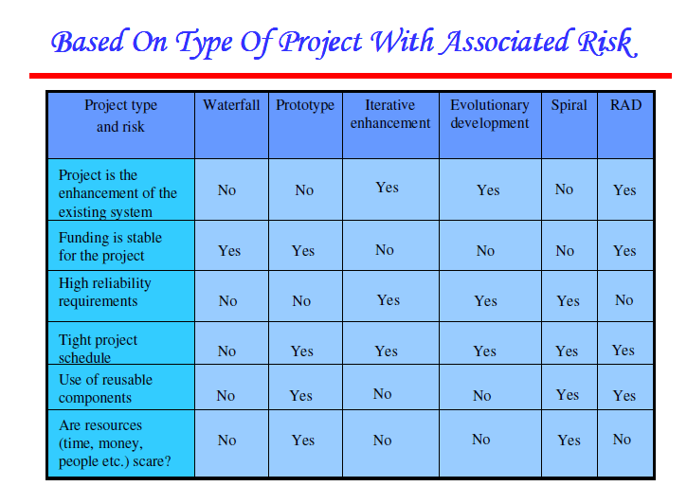

Slide 63
SOFTWARE REQUIREMENTS: ANALYSIS AND SPECIFICATION

Slide 64
Requirement engineering
Requirements describe “What” not “How”
Produces one large document in natural language contains a description of what the system will do without describing how it will do it.
Without well written document
Developers do not know what to build
Customers do not know what to expect
What to validate

Slide 65
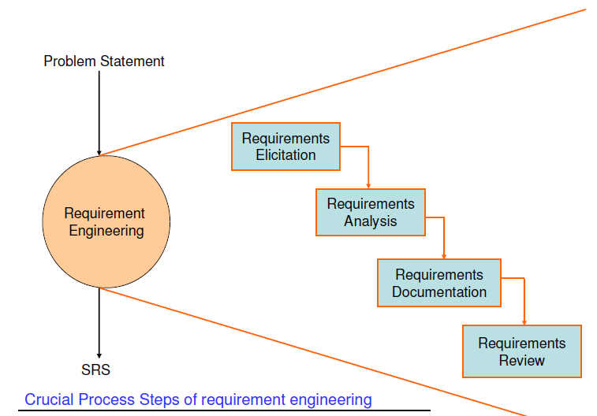

Slide 66
Requirement Engineering
It is the disciplined application of proven principles, methods, tools, and notations to describe a proposed system’s intended behavior and its associated constraints.
SRS may act as a contract between developer and customer.

Slide 67
Type of requirements:
Known requirements - Something a stakeholder believes to be implemented.
Unknown requirements - Forgotten by the stakeholder because they are not needed right now or needed only by another stakeholder.
Undreamt requirements - Stakeholder may not be able to think of new requirements due to limited domain knowledge.
Stakeholder: It is used to refer to anyone who may have some direct or indirect influence on the system requirements.

Slide 68
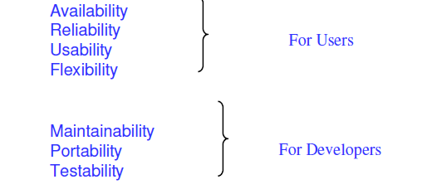
Software requirements are broadly classified as functional and non functional requirements.
Functional requirements - These are related to the expectations from the intended software.
Non-functional requirements - They are mostly quality requirements that stipulate how well the software does what it has to do.

Slide 69
User and System Requirements:
User requirements are written for the users and include functional and non- functional requirements.
System requirements are derived from user requirements.
They are expanded form of user requirements.
They may be used as input to the designers for the preparation of software design document.

Slide 70
FEASIBILITY STUDIES
Cancelling a project is in itself, neither good nor bad.
Cancelling a project later than necessary is bad.
The trick is to perform the minimum of work necessary to determine whether the project should be cancelled.
How do we cancel a project with the least work?
Most effective way: To conduct a feasibility study to determine whether the full scale project is workable.
Result: Feasibility report which enables project team, customer, or upper management make a go/no go decision.

Slide 71
Technical feasibility or non-technical feasibility?
If technically feasible, then why conduct a feasibility study?
For eg., assessing the technical feasibility to design a programming language using “Sanskrit”.
However, for most projects feasibility depends on non-technical issues like:
Are the project’s cost and schedule assumptions realistic?
Is the business model realistic?
Is there any market for the product?
Notes:
Business Model: A plan for the successful operation of a business, identifying sources of revenue, the intended customer base, products, and details of financing.

Slide 72
Purpose of feasibility studies:
A feasibility study is defined as an evaluation or analysis of the potential impact of a proposed project or program.
Conducted to assist decision makers in determining whether or not to implement a project/program.
Based on extensive research on both the current practices and the proposed project/program and its impact on the system as a whole.
It should also contain extensive data analysis related to financial and operational impact and should include advantages and disadvantages of both the current situation and the proposed project.

Slide 73
Focus of Feasibility Studies
Steve McConnel has given the following points on which a feasibility study should focus and give proper emphasis to get good results:
Is the product concept viable?
Will it be possible to develop a product that matches the project’s vision statement?
What are the current estimated cost and schedule for the project?
How big is the gap between the original cost and schedule targets and current estimates?

Slide 74
Is the business model for software justifies when the current cost and schedule estimates are considered?
Are the specifications complete and stable enough to support remaining development work?
Have users and developers been able to agree on a detailed user interface prototype?
Is the software development plan complete and adequate to support further development work?

Slide 75
Requirements Elicitation:
Most difficult, most critical, most error-prone and most communication intensive aspect of software development.
Elicitation can succeed only through and effective customer-developer partnership.
Developers and Users have different mind set, expertise and vocabularies.
Communication gap might lead to inconsistencies, misunderstanding and omission of requirements.

Slide 76
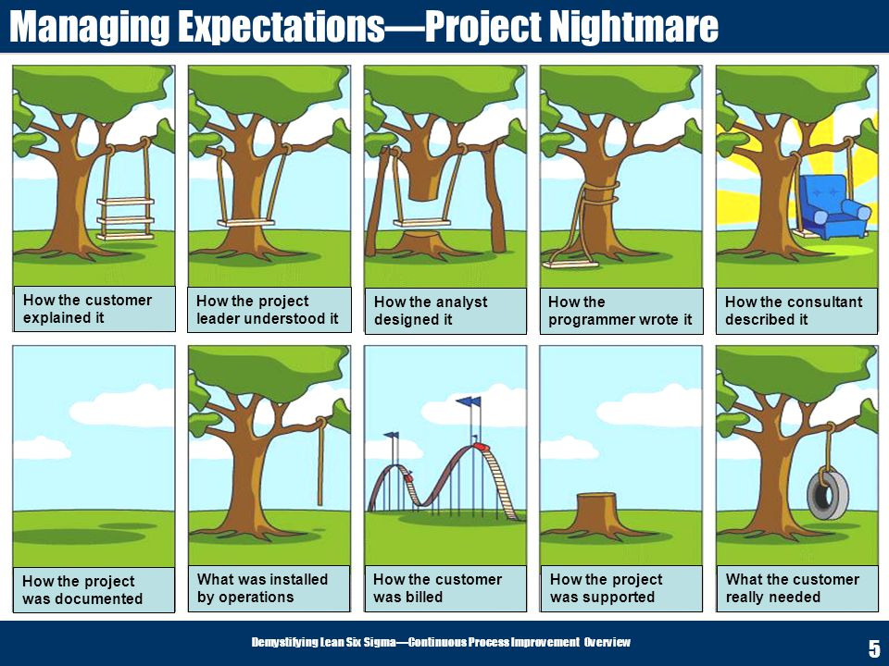

Slide 77
Methods for requirements elicitation
1. Interviews:
After receiving the problem statement from the customer, the first step is to arrange a meeting with the customer.
Specialised developers called “requirements engineers” interact with the customer.
The objective is to understand the customer’s expectations from the software.

Slide 78
Interview may be open-ended or structured.
In an open-ended interview, there is no pre-set agenda.
Context free questions may be asked to understand the problem and to have an overview of the situation.
For eg., for a “result management system”, requirement engineer may ask:
Who is the controller of examination?
Who has requested such a software?
How many officers are placed in the examination division?
Who will use the software?
Who will explain the manual system?
Is there any opposition for this project?
How many stakeholders are computer friendly?

Slide 79
In structured interview, agenda of fairly open questions is prepared.
Sometimes a proper questionnaire is designed for the interview.
Interview may be started with simple questions to set people at ease.
Specific questions may be asked to understand the requirements.

Slide 80
Selection of Stakeholder:
It will be impossible to interview every stakeholder.
Thus, representatives from groups must be selected based on their technical expertise, domain knowledge, credibility and accessibility.
There are several groups to be considered for conducting interviews:
Entry level personnel
Mid-level Stakeholders
Managers or other stakeholders
Users of the software

Slide 81
2. Brainstorming Sessions:
A group technique which may lead to new ideas quickly and help to promote creative thinking.
It is intended to generate lots of ideas, with full understanding that they may not be useful.
The theory is that having long list of requirements to choose from is far superior than starting with a blank slate.
Requirements in the long list can be categorized, prioritized, and pruned.

Slide 82
Brainstorming sessions promotes-
creative thinking
generate new ideas
provides platform to share views, apprehensions and difficulties of implementation.
All participants are encouraged to say whatever ideas come to mind, whether they may seem relevant or not.
No one will be criticized for any idea, no matter how goofy it seems
It is carried out with specialized groups like actual users, middle level managers, etc.
A highly trained facilitator is required to handle group bias and group conflicts carefully.

Slide 83
3. Facilitated Application Specification Technique
Similar to brainstorming sessions and the objective is to bridge the expectation gap.
The basic guidelines for FAST are:
Arrange for a meeting at a neutral site for developers and customers.
Establishment of rules for preparation and participation.
Prepare an informal agenda that encourages free flow of ideas.
Appoint a facilitator to control the meeting.
A facilitator may be a developer, a customer, or an outside expert.

Slide 84
Prepare a definition mechanism- board, flip charts, worksheets, wall stickers, etc.
Participants should not criticize or debate.
FAST session preparations:
Each FAST attendee is asked to make a list of objects that are:
part of the environment that surrounds the system.
produced by the system.
used by the system.

Slide 85
Activities of FAST session:
Each participant presents his or her lists of objects, services, constraints, and performance for discussion.
List may be displayed in the meeting by using board, large sheet of paper or any other mechanism, so that they are visible to all the participants.
The combined lists for each topic are prepared by eliminating redundant entries and adding new ideas.
The combined lists are again discussed and consensus lists are finalized by the facilitator.
Once the consensus lists have been completed, the team is divided into smaller sub teams, each works to develop mini-specifications for one or more entries of the lists.

Slide 86
During all discussions, the team may raise an issue that cannot be resolved during the meeting.
An issues list is prepared so that these ideas will be considered later.
Each attendee prepares a list of validation criteria for the product/system and presents the list to the team. A consensus list of validation criteria is then created.
A sub team may be asked to write the complete draft specifications using all inputs from the FAST meeting.

Slide 87
4. Quality Function Deployment:
It is a quality management technique that helps to incorporate the voice of the customer.
The voice is then translated into technical requirements.
These technical requirements are documented and results is the software requirements and specification document.
These requirements are further translated into design requirements.
Three types of requirements are identified:
1. Normal requirements
2. Expected requirements
3. Exciting requirements

Slide 88
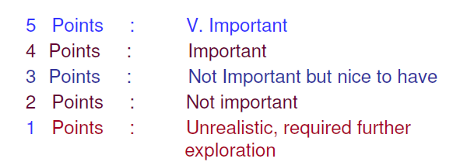
QFD method has the following steps:
Identify all the stakeholders
List out requirements from customer
A value indicating a degree of importance, is assigned to each requirement.
Thus, customer determines the importance of each requirement on a scale of 1 to 5

Slide 89
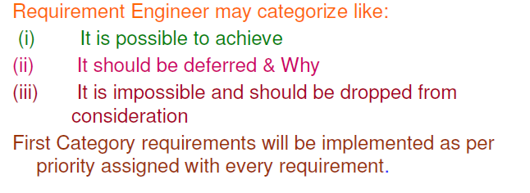

Slide 90
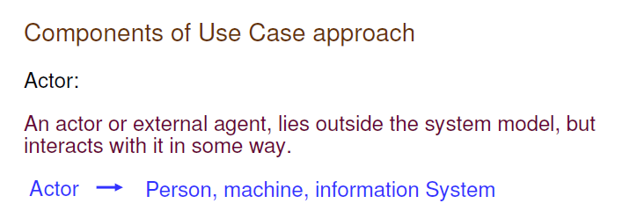
5. The Use Case Approach:
This approach uses a combination of text and pictures in order to improve the understanding of requirements.
The Use cases describe “what” of a system and not “how”.
They only give functional view of the system.

Slide 91



Slide 92


Slide 93


Slide 94


Slide 95


Slide 96


Slide 97


Slide 98


Slide 99


Slide 100


Slide 101


Slide 102


Slide 103


Slide 104


Slide 105


Slide 106


Slide 107



Slide 108


Slide 109


Slide 110


Slide 111


Slide 112



Slide 113


Slide 114


Slide 115


Slide 116



Slide 117


Slide 118


Slide 119


Slide 120


Slide 121


Slide 122


Slide 123


Slide 124



Slide 125


Slide 126


Slide 127


Slide 128


Slide 129


Slide 130


Slide 131


Slide 132


Slide 133


Slide 134


Slide 135


Slide 136


Slide 137


Slide 138


Slide 139

REQUIREMENTS ANALYSIS:

Slide 140


Slide 141


Slide 142


Slide 143


Slide 144
Basic rules that apply to all DFDs:
No internal logic should be shown like loops, if-else, etc. This is not a flow chart.
In order to keep the diagram uncluttered, you can repeat data stores and external entities.
No process can have only output data flows( a miracle).
No process can have only input flows( black hole).
Data cannot be moved directly from one store to another without a process.
Data cannot move directly from an external entity to a data store without a process.
Data stores can’t be sink( only input data flows) or source( only output data flows) in level 1 DFD.

Slide 145

Requirements Documentation:
Represents requirements in a consistent format.
The requirements document called Software Requirements Specification(SRS) is produced.

Slide 146
Nature of the SRS:
The basic issues that the SRS writer(s) shall address are the following:
Functionality
External Interfaces
Performance
Speed, response time, recovery time, etc.
Attributes
Portability, correctness, maintainability, security, reliability
Design constraints imposed on Implementation
Implementation language, policies for database integrity, resource limits, operating environment.

Slide 147
Characteristics of a good SRS:
The SRS should be:
Correct
An SRS is correct if and only if every requirement stated therein is one that the software shall meet.
Unambiguous
An SRS is unambiguous if and only if, every requirement stated therein has only one interpretation.
Eg. Ambiguous: A student will have either undergraduate courses or post-graduate courses but not both. Some courses will be open to both under-graduate and post-graduate
A student will have either under-graduate or post graduates but not both

Slide 148
3. Complete
An SRS is complete if and only if, it includes the following elements:
All significant requirements, whether related to functionality, performance, design constraints, attributes or external interfaces.
Responses to both valid and invalid inputs.
Full label and references to all figures, tables and diagrams in the SRS and definition of all terms and unites of measures.
4. Consistent
An SRS is consistent if and only if, no subset of individual requirements described in it conflict.
5. Ranked for importance and/or stability
If an identifier is attached to every requirement to indicate either the importance or stability of that particular requirement.
6. Verifiable
An SRS is verifiable, if and only if , every requirement stated therein is verifiable.

Slide 149
7. Modifiable
An SRS is modifiable, if and only if, its structure and style are such that any changes made to the requirements can be made easily, completely, and consistently while retaining structure and style.
8. Traceable
An SRS is traceable, if the origin of each of the requirements is clear and of it facilitates the referencing of each requirement in future development or enhancement documentation.

Slide 150


Slide 151


Slide 152


Slide 153



Slide 154


Slide 155


Slide 156


Slide 157



Slide 158



Slide 159


Slide 160


Slide 161


Slide 162


Slide 163



Slide 164


Slide 165


Slide 166


Slide 167



Slide 168


Slide 169


Slide 170


Slide 171


Slide 172



Slide 173


Slide 174


Slide 175


Slide 176


Slide 177


Slide 178


Slide 179


Slide 180



Slide 181


Slide 182


Slide 183


Slide 184


Slide 185


Slide 186


Slide 187


Slide 188


Slide 189


Slide 190


Slide 191


Slide 192


Slide 193


Slide 194


Slide 195


Slide 196



Slide 197



Slide 198
Requirements Validation:
Objective: To certify that the SRS document is an acceptable document of the system to be implemented.
Difference between Analysis and Validation:
Analysis works with raw requirements as elicited from the various stakeholders
whereas validation works with a final draft of the SRS document with negotiated and agreed requirements.

Slide 199
After the completion of the SRS document, we may like to check the document for:
Completeness and consistency
Conformance to standards
Requirements conflicts
Technical errors
Ambiguous requirements

Slide 200


Slide 201

Requirements Reviews:
A popular requirements validation technique where a group of people will read the SRS document and look for possible problems.

Slide 202
Plan Review
Select review team, time and place
Distribute SRS document
Read SRS document
To find conflicts, omissions, inconsistencies, deviations from standards and other problems.
Organize review meeting
Problems are discussed
Set of actions to address the problem is approved.
Follow-up actions
Checks that the approved actions have been carried out.
Revise SRS document
Revised to reflect the approved actions.

Slide 203


Slide 204
Review Checklists:
Understandability
Redundancy
Completeness
Ambiguity
Consistency
Conformance to Standards
Tracebility

Slide 205
Requirements Management:
It is the process of understanding and controlling changes to system requirements.
Most requirements are dependent on each other.
Hence, one change may have implications on other dependent requirements and thus make the task much more difficult and challenging.

Slide 206
Requirements are broadly classified in two categories i.e., enduring and volatile.
Enduring requirements: These are core requirements and are related to main activity of the organization.
Stable and not changed easily.
Volatile requirements: These requirements are likely to change during software development life cycle even after delivery of the product.
Reasons for changes:
Changes to the environment
Changes in technology
Changes in policies
Changes in customer’s expectations

Slide 207
Requirements Management Planning
Requirements Change Management
The requirements change process should include the following activities to be carried out when a change is needed in the requirements:
Allocating adequate resources( assignment of responsibilities)
Analysis of requirement changes (management of changes)
Documenting requirements (Documentation)
Creating requirements trace throughput the project life cycle from inception to the final work products (requirements traceability)
Establishing team (communication of change)

